Slide 1

Voting web application using django framework
By:
Mydeen Fathima.U
au951221104027
Jp college of engineering

Slide 2
Abstract
Django poll application is a full featured polling application. This application Features are the user have to register in this application to show the polls and to vote. If user already voted, he cannot vote again. Only the owner of a poll can add poll, edit poll, update poll, delete poll, and choice, update choice, delete choice and end a poll. Ended poll only shows user the final result of the poll. There is a search option for polls to search particular poll. User can filter polls by name, publish date, and by number of voted pagination will work even after applying filter.Django poll application is a full featured polling application. This application Features are the user have to register in this application to show the polls and to vote. If user already voted, he cannot vote again. Only the owner of a poll can add poll, edit poll, update poll, delete poll, and choice, update choice, delete choice and end a poll. Ended poll only shows user the final result of the poll. There is a search option for polls to search particular poll. User can filter polls by name, publish date, and by number of voted pagination will work even after applying filter.

Slide 3
Problem statement
The present voting system applicable has proved inefficient as the voters’ registration process is slow, the manual collation of results takes time and gives room for result manipulation, also the inaccessible nature of election venues which includes the long distances to be covered by voters’ to their registered location increases voters apathy towards the election processes, and finally the issues of ballot box snatching and damage

Slide 4
Project overview
Voting as a term encompasses a broad range of voting systems that apply elements in one or more steps of the cycle. There are many levels to voting in a broad sense which could be collation, verification, internet voting, remote online voting e.t.c. Following the definition of a system as anything that takes an input and gives an output, an voting system is any system that can offers both electronic and online voting. It could also incorporate registration, verification, collation, remote online voting and real-time result display. An voting system generally comprises the following for it to work efficiently:An interactive voting user interface on an device which provides a friendly environment for voters to authenticate and cast their votes, it also serves as a means of collection the individual votes and storing them in the local and central database.An administrative dashboard for voters registration, details update and coordination and monitoring.A database management system for the storage of election, voting and voters data.A result display interface.Voting system serves to reduce the cumulative costs of running and increase voters participation in election system as it offers voters an easy and convenient way to vote

Slide 5
Proposed solution
Maintain all information of all the candidates and votes. Check whether voter have voted or not. Increase the voting percentage. To make voting an easy process by avoiding problems like. • Security Booth capturing

Slide 6
Technology used
Front end
HTML
Backend
DJANGO

Slide 7
Coding
From django.db import models class Question(models.Model): question_text =models.CharField(max_length = 200) pub_date= models.DateTimeField(‘date published’) def __str__(self): return self.question_text class Choice(models.Model): question = models.ForeignKey(Question, on_delete = models.CASCADE) choice_text = models.CharField(max_length = 200) votes = models.IntegerField(default = 0) def __str__(self): return self.choice_text
From django.contrib import admin from .models import Question, Choice admin.site.register(Question) admin.site.register(Choice) admin.site.site_header = “Pollster Admin” admin.site.site_title = “Pollster Admin Area” admin.site.index_title = “Welcome to the Pollster Admin Area” class ChoiceInLine(admin.TabularInline): model = Choice extra = 3 class QuestionAdmin(admin.ModelAdmin): fieldsets = [(None, {‘fields’: [‘question_text’]}), (‘Date Information’, { ‘fields’: [‘pub_date’], ‘classes’: [‘collapse’]}), ] inlines = [ChoiceInLine] admin.site.register(Question, QuestionAdmin)
From django.template import loader from django.http import HttpResponse, HttpResponseRedirect from django.shortcuts import get_object_or_404, render from django.urls import reverse from .models import Question, Choice def index(request): latest_question_list = Question.objects.order_by(‘-pub_date’)[:5] context = {‘latest_question_list’: latest_question_list} return render(request, ‘polls / index.html’, context) def detail(request, question_id): try: question = Question.objects.get(pk = question_id) except Question.DoesNotExist: raise Http404(“Question does not exist”) return render(request, ‘polls / detail.html’, {‘question’: question}) def results(request, question_id): question = get_object_or_404(Question, pk = question_id) return render(request, ‘polls / results.html’, {‘question’: question} def vote(request, question_id): print(request.POST[‘choice’]) question = get_object_or_404(Question, pk = question_id) try: selected_choice = question.choice_set.get(pk =request.POST[‘choice’]) except (KeyError, Choice.DoesNotExist): return render(request, ‘polls / detail.html’, { ‘question’: question, ‘error_message’: “You didn’t select a choice.”, }) else: selected_choice.votes += 1 selected_choice.save() return HttpResponseRedirect(reverse(‘polls:results’, args =(question.id, )))

Slide 8
From django.urls import path from . Import views app_name = ‘polls’ urlpatterns = [ path(‘’, views.index, name =‘index’),path(‘<int:question_id>/’, views.detail, name =‘detail’), path(‘<int:question_id>/results/’, views.results, name =‘results’), path(‘<int:question_id>/vote/’, views.vote, name =‘vote’), ]
TEMPLATES = [{ ‘BACKEND’: ‘django.template.backends.django.DjangoTemplates’, ‘DIRS’: [os.path.join(BASE_DIR, ‘templates’)], ‘APP_DIRS’: True, ‘OPTIONS’: { ‘context_processors’: [ ‘django.template.context_processors.debug’, ‘django.template.context_processors.request’, ‘django.contrib.auth.context_processors.auth’, ‘django.contrib.messages.context_processors.messages’], }, }, ]

Slide 9
{% extends ‘base.html’ %} {% block content %} <h1 class=“text-center mb-3”>Poll Questions</h1> {% if latest_question_list %} {% for question in latest_question_list %} <div class=“card-mb-3”> <div class=“card-body”>
<p class=“lead”>{{ question.question_text }}</p> <a href=“{% url ‘polls:detail’ question.id %}” class=“btn btn-primary btn-sm”>Vote Now</a> <a href=“{% url ‘polls:results’ question.id %}” class=“btn btn-secondary btn-sm”>Results</a> </div>
</div>
{% endfor %} {% else %} <p>No polls available</p> {% endif %} {% endblock %}
{% extends ‘base.html’ %} {% block content %} <h1 class=“mb-5 text-center”>{{ question.question_text }}</h1> <ul class=“list-group mb-5”> {% for choice in question.choice_set.all %} <li class=“list-group-item”> {{ choice.choice_text }} <span class=“badge badge-success float-right”>{{ choice.votes }} vote{{ choice.votes | pluralize }}</span> </li> {% endfor %} </ul> <a class=“btn btn-secondary” href=“{% url ‘polls:index’ %}”>Back To Polls</a> <a class=“btn btn-dark” href=“{% url ‘polls:detail’ question.id %}”>Vote again?</a> {% endblock %}

Slide 10
<nav class=“navbar navbar-dark bg-primary mb-4”>
<div class=“container”>
<a class=“navbar-brand” href=“/”>Pollster</a> </div>
</nav>
<!DOCTYPE html> <html lang="en"> <head> <link rel="stylesheet" href=https://stackpath.bootstrapcdn.com/bootstrap/4.4.1/css/bootstrap.min.css integrity="sha384-Vkoo8x4CGsO3+Hhxv8T/Q5PaXtkKtu6ug5TOeNV6gBiFeWPGFN9MuhOf23Q9Ifjh" crossorigin="anonymous"> <title>Pollster {% block title %}{% endblock %}</title> </head> <body> <!--NavBar--> {% include 'partials/_navbar.html'%} <div class="container"> <div class="row"> <div class=".col-md-6 m-auto"> {% block content %} {% endblock%} </div> </div> </div> </body> </html>

Slide 11
From django.shortcuts import render Def index(request): return render(request, ‘pages / index.html’)
From django.urls import path from . Import views urlpatterns = [path(‘’, views.index, name =‘index’), ]
{% extends ‘base.html’ %} {% block content %} <div class=“card text-center”> <div class=“card-body”> <h1>Welcome To Pollster!</h1> <p>This is an Polling Web Application built with Django</p> <a class=“btn btn-dark” href=“{% url ‘polls:index’ %}”>View Available Polls</a> </div> </div> {% endblock %}
From django.contrib import admin from django.urls import include, path urlpatterns = [ path(‘’, include(‘pages.urls’)), path(‘polls/’, include(‘polls.urls’)), path(‘admin/’, admin.site.urls), ]

Slide 12
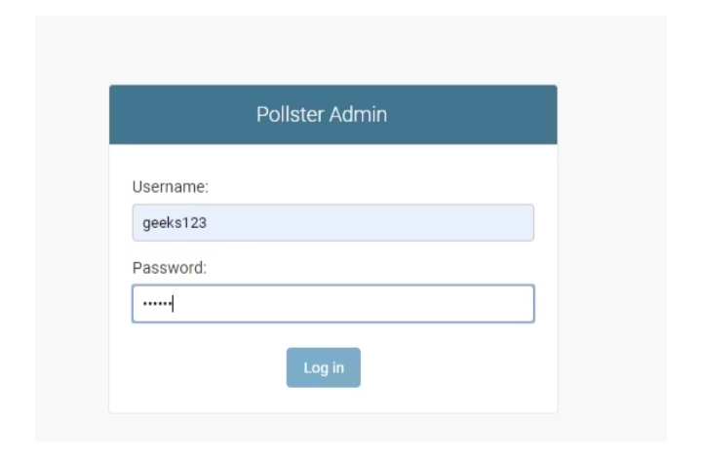
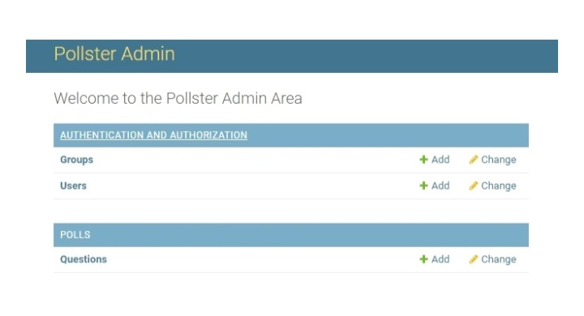

Slide 13
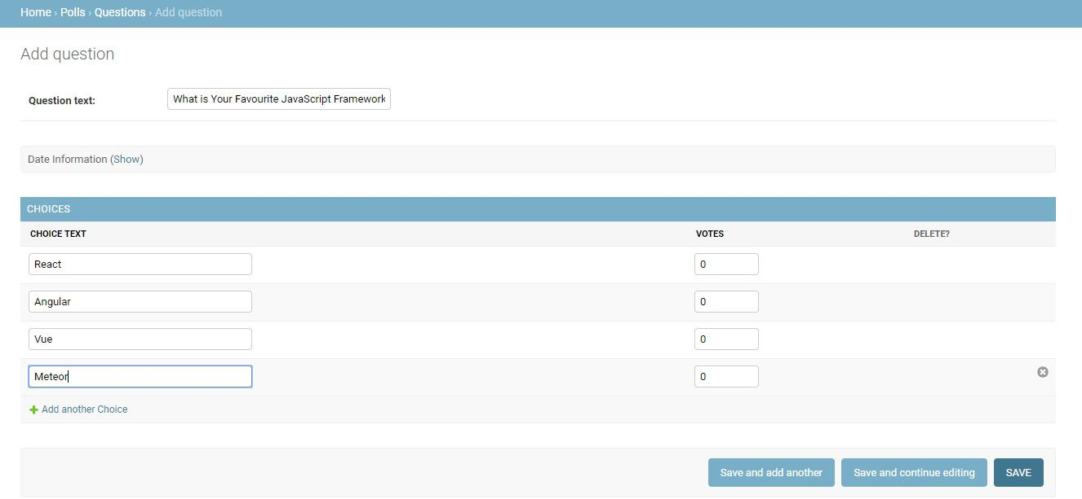

Slide 14
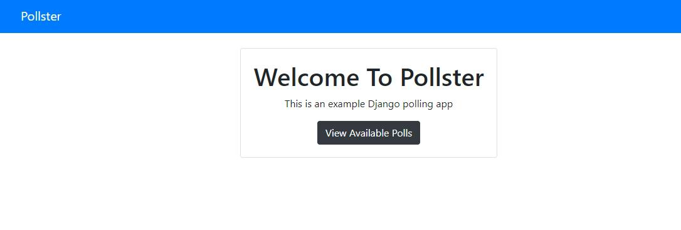

Slide 15
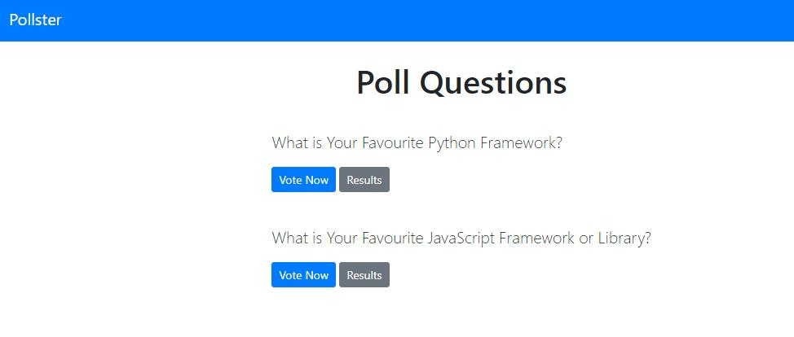

Slide 16
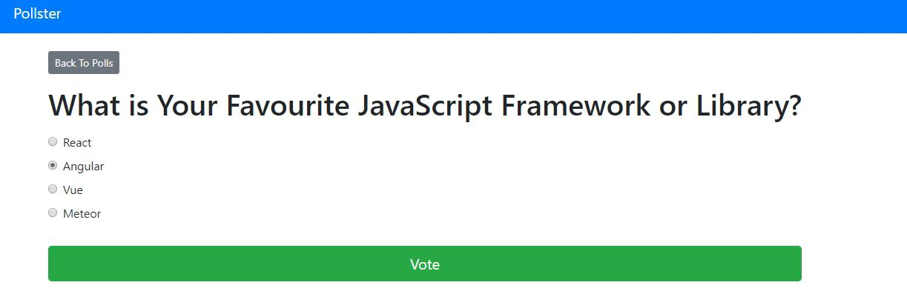

Slide 17
